Slide 1
Using themes
Christopher Harrison
@geektrainer
Content Developer
Microsoft

Slide 2
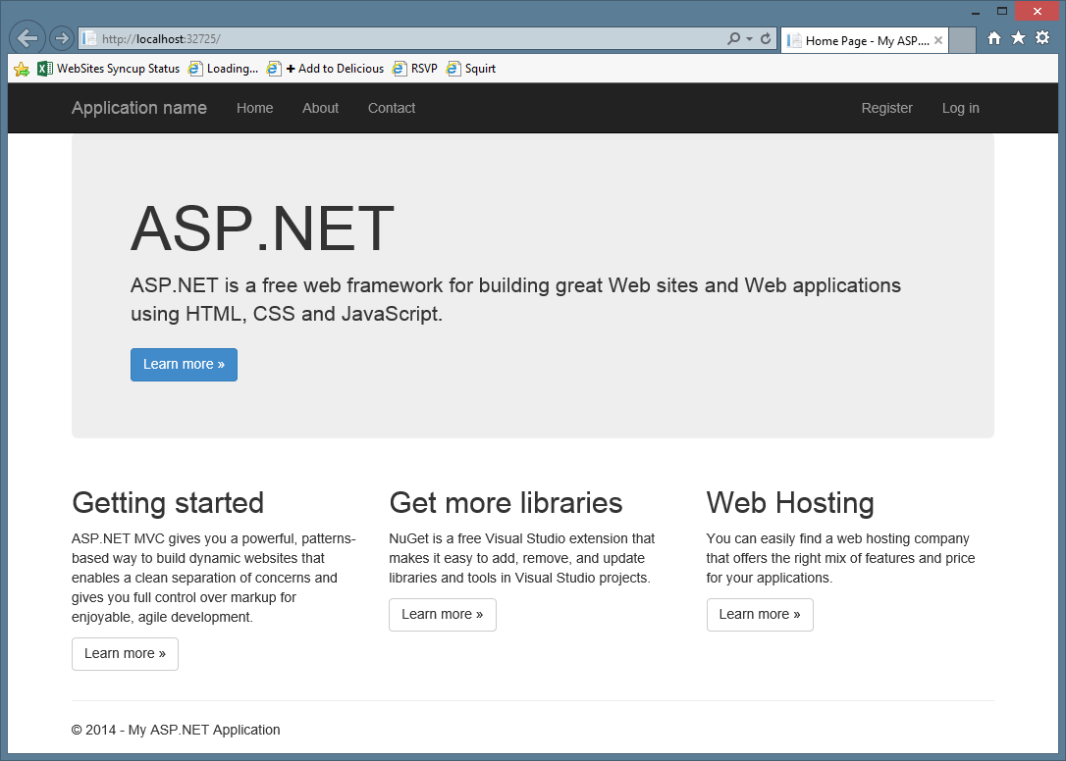

Slide 3
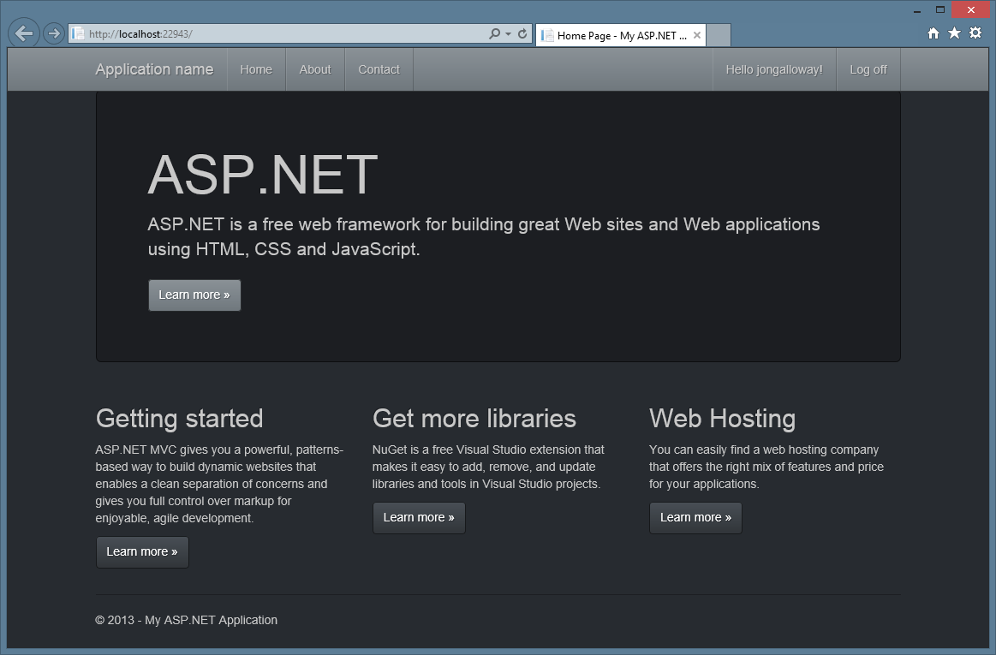

Slide 4
Bootstrap themes

